Slide 1



365 Customer Engagement Strategy
365 Data Science
Data Analyst: Pricila Miguel
Last Updated: June 2024

Slide 2
Objective: Improve retention and engagement rates
Data collected: January 01, 2022 – October 31, 2022
Career track, course, and student engagement metrics
Key questions we aim to address:
How engaged are the students inside the platform, and how can this metric be improved?
How long do students stay engaged on the platform, and how can this period be extended?
What’s the difference in behavior between free and paid students?
Which are the most popular courses on the platform?
How many students sit for an exam?

Slide 3
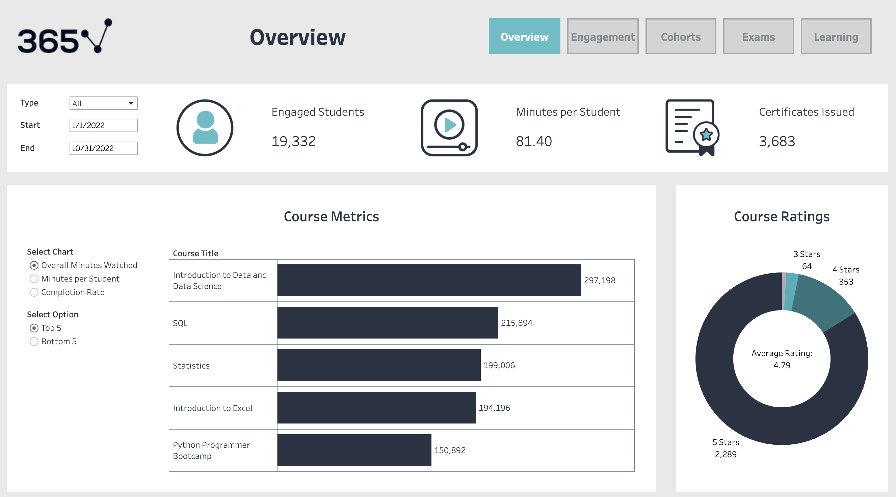

Slide 4
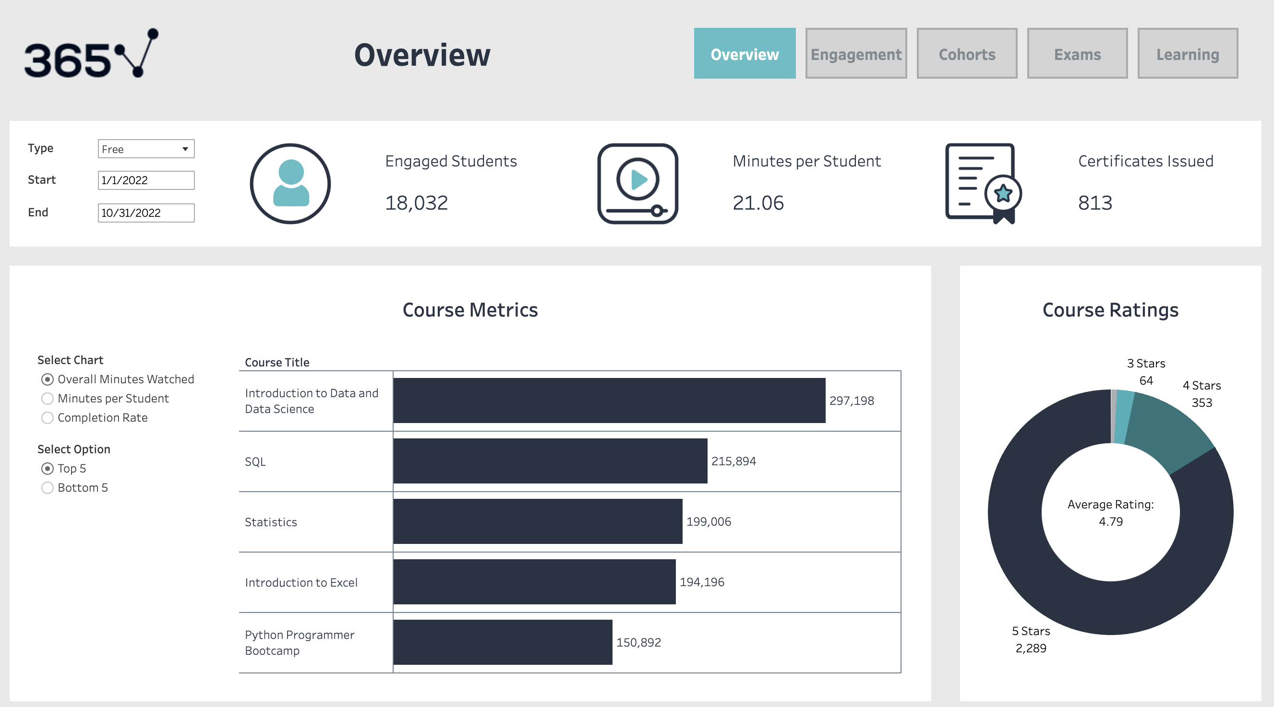

Slide 5


Slide 6
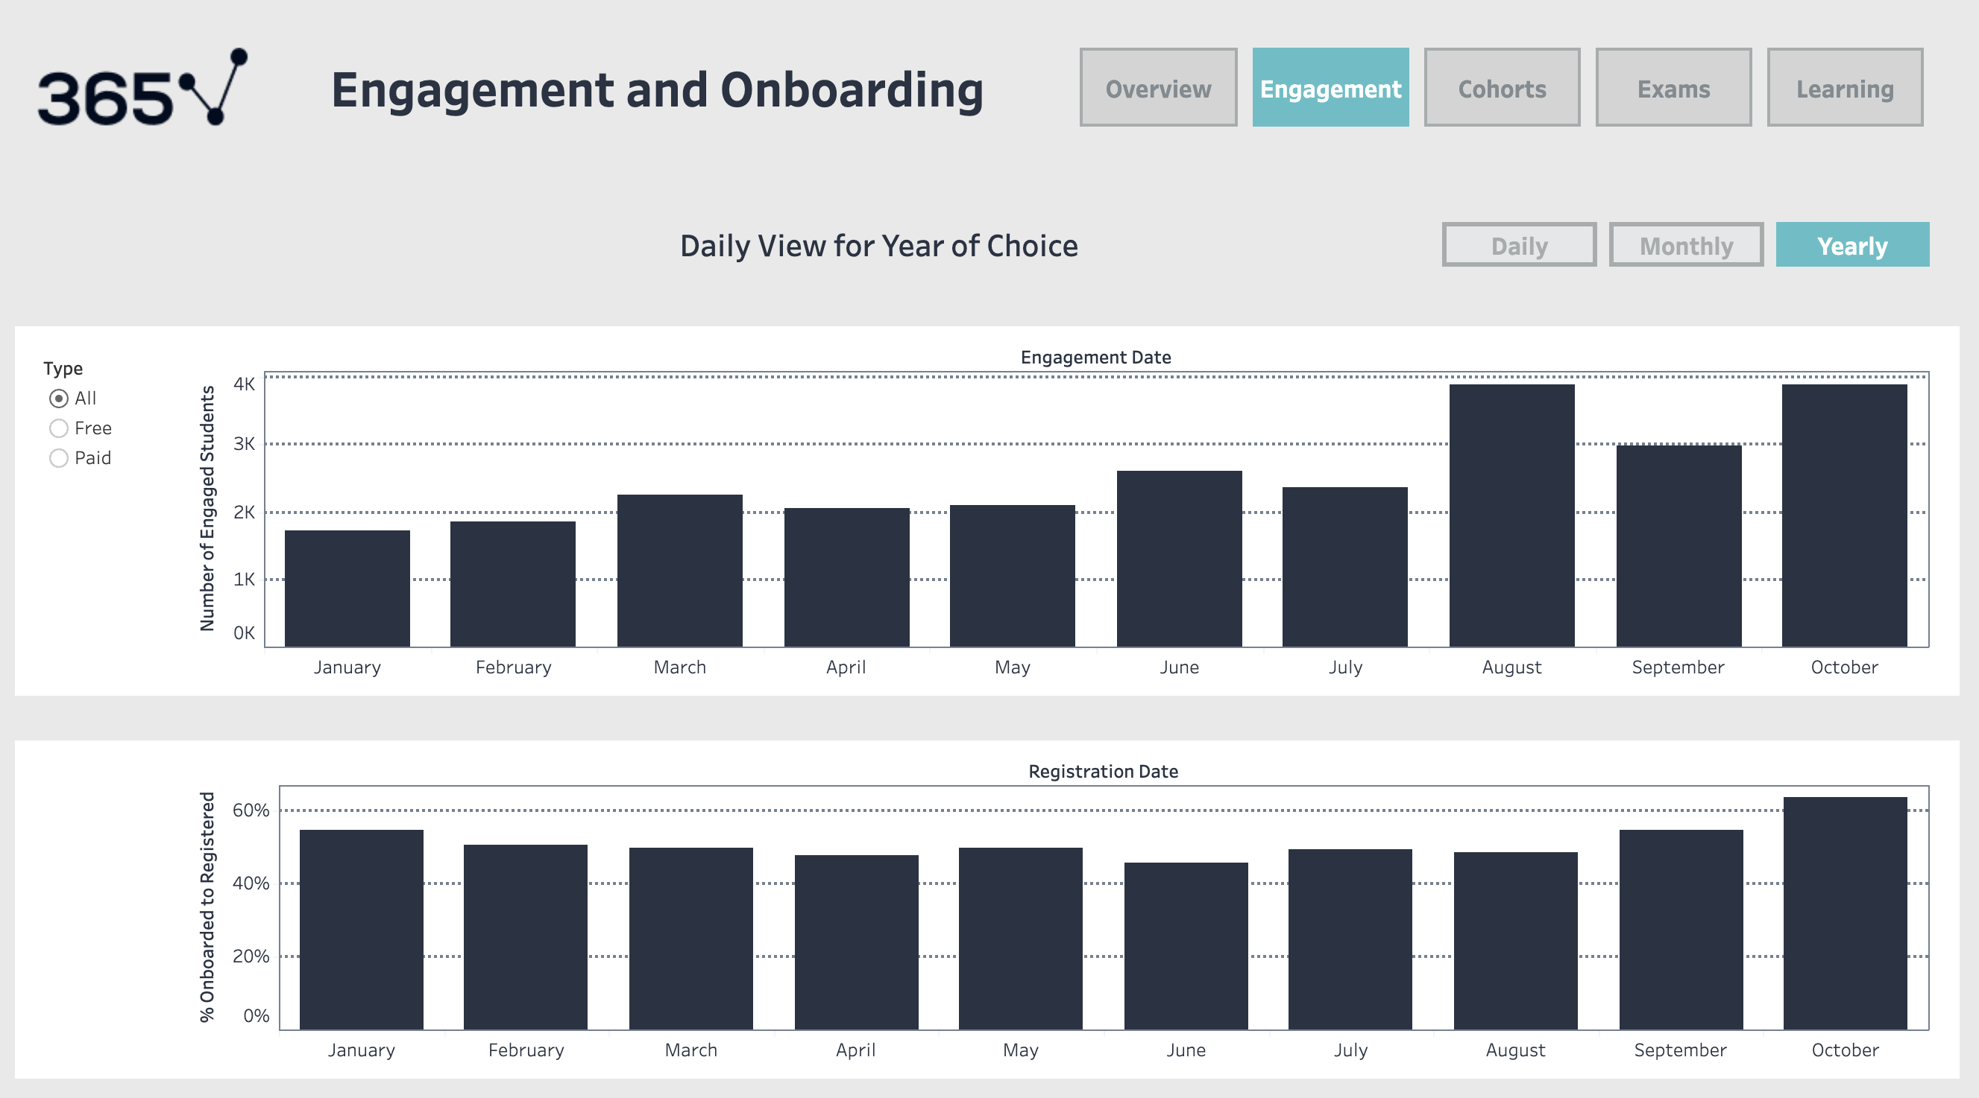

Slide 7
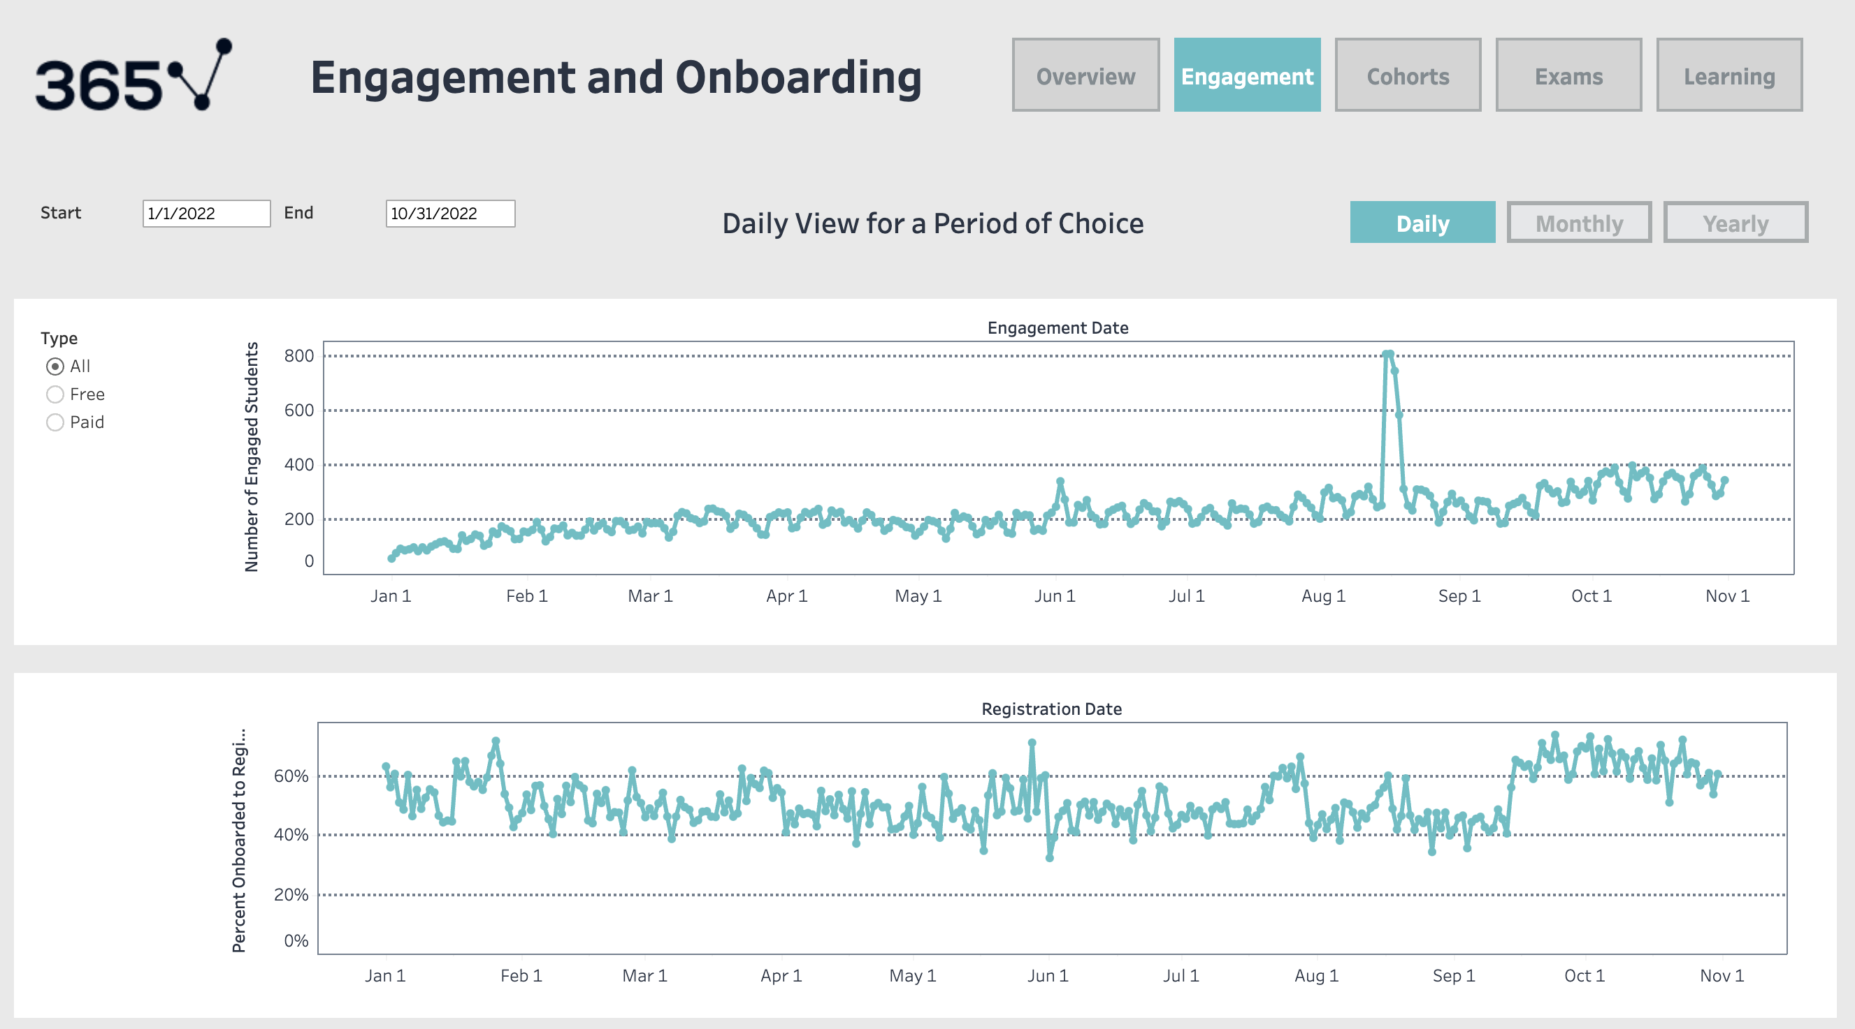
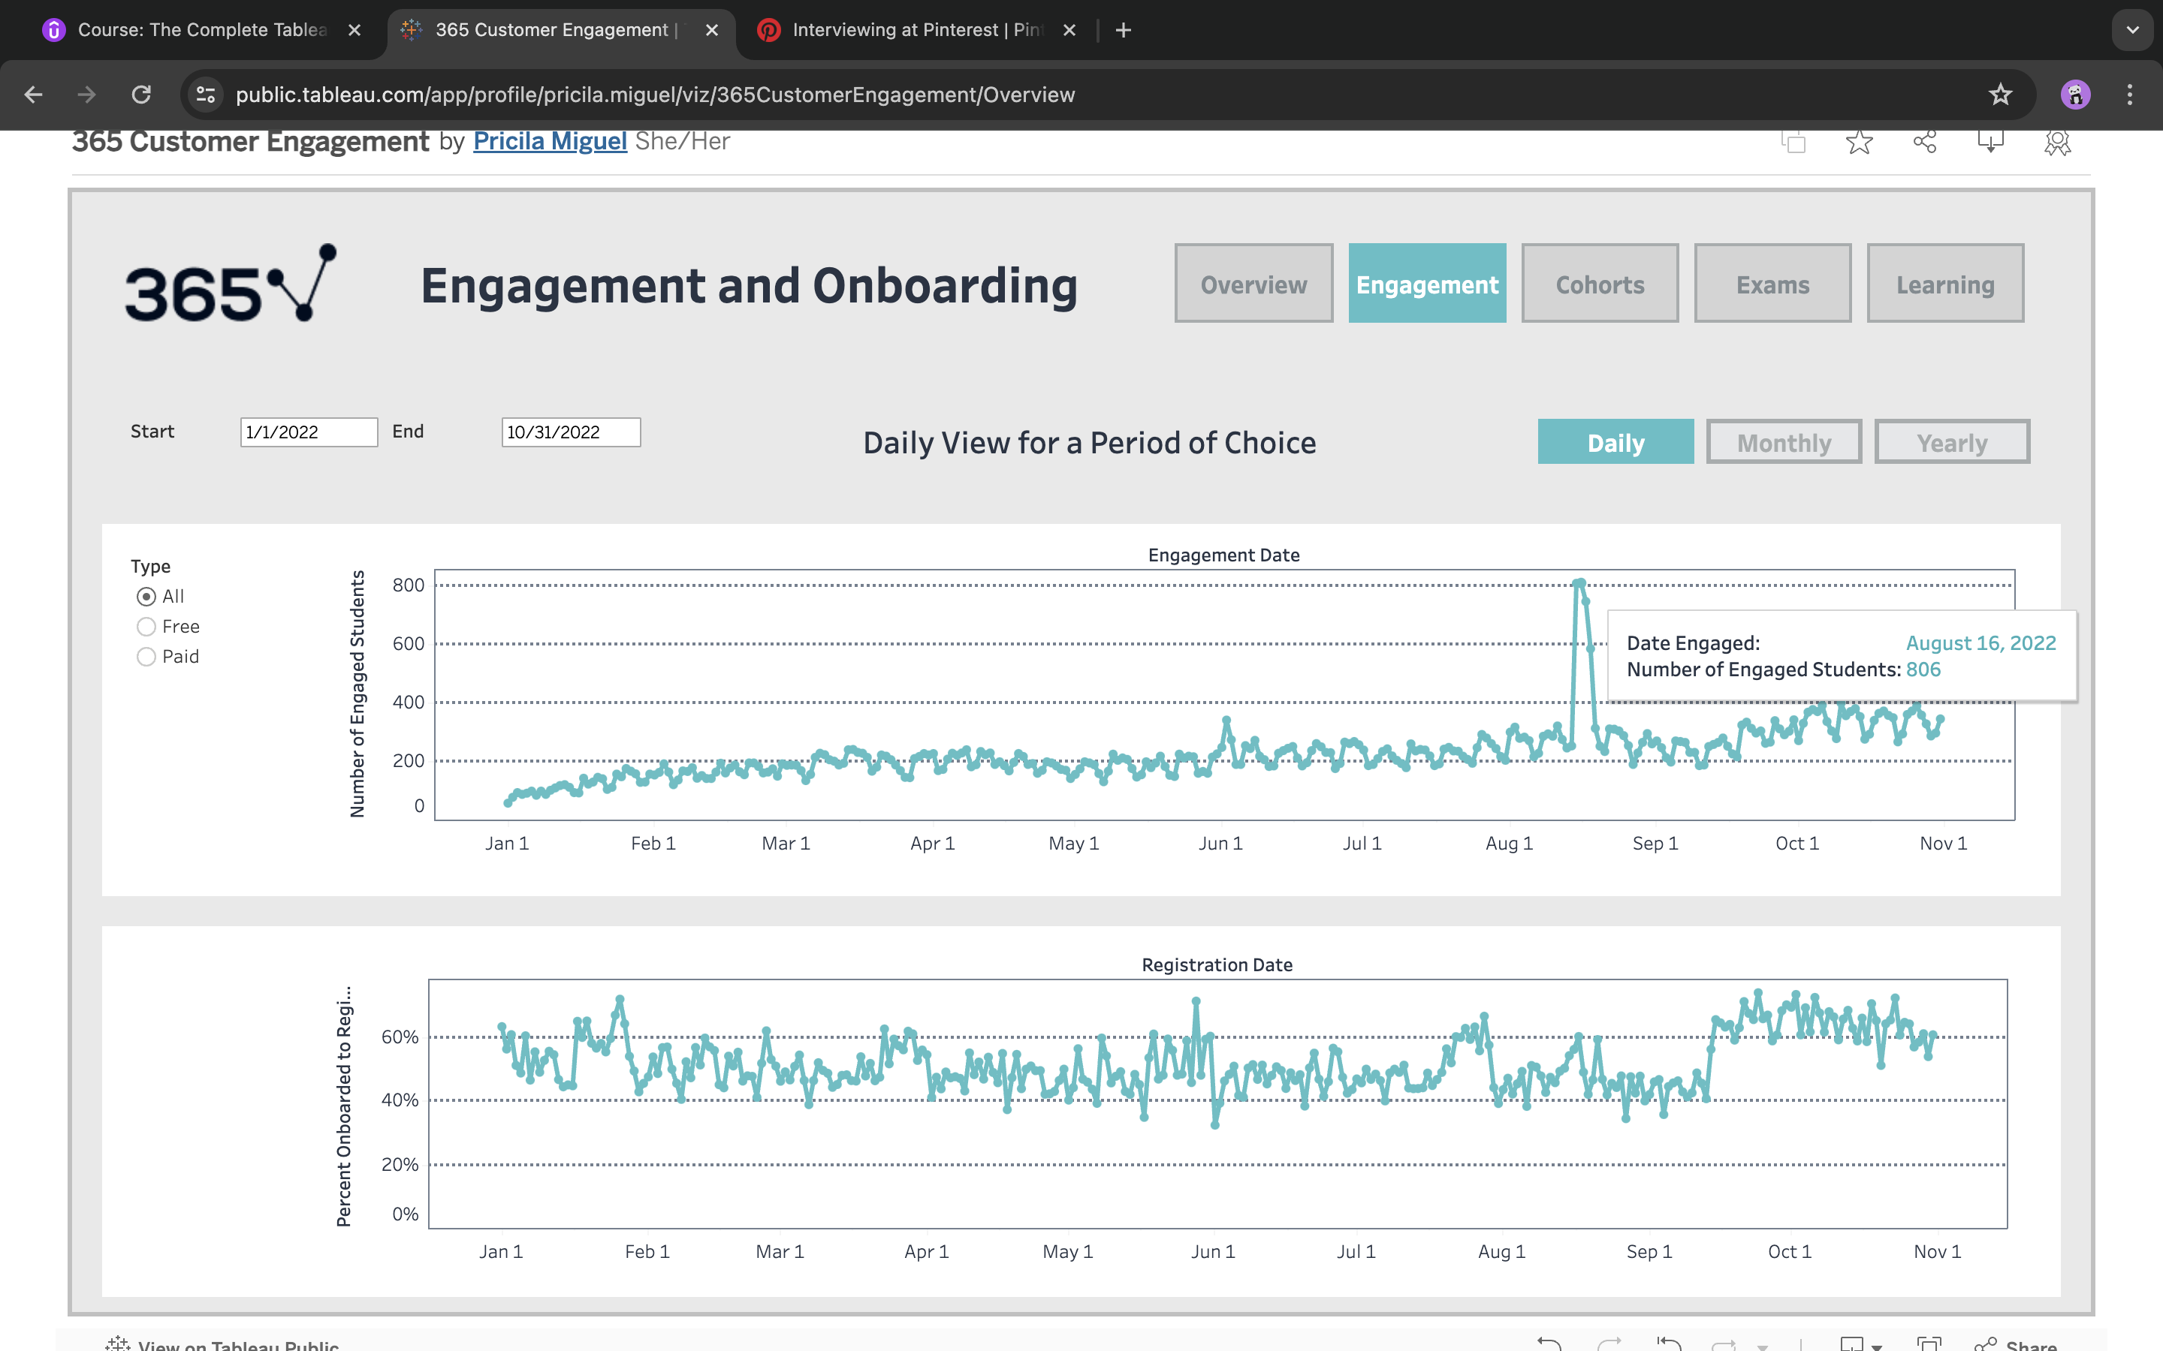

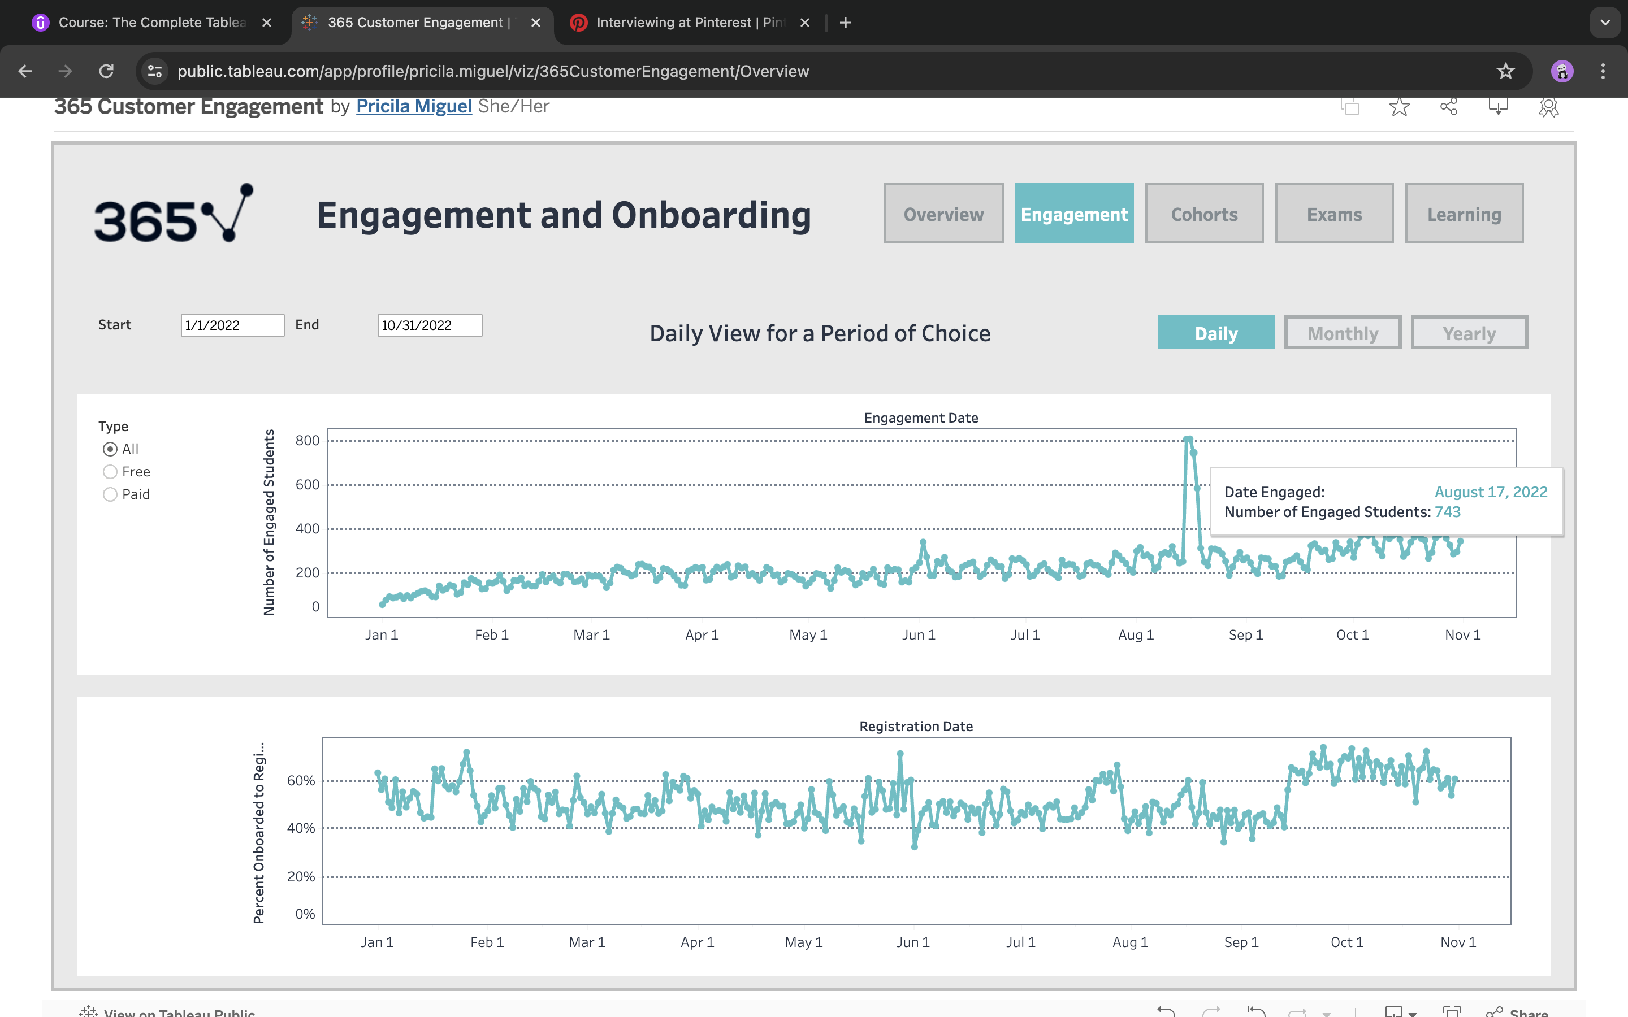

Slide 8
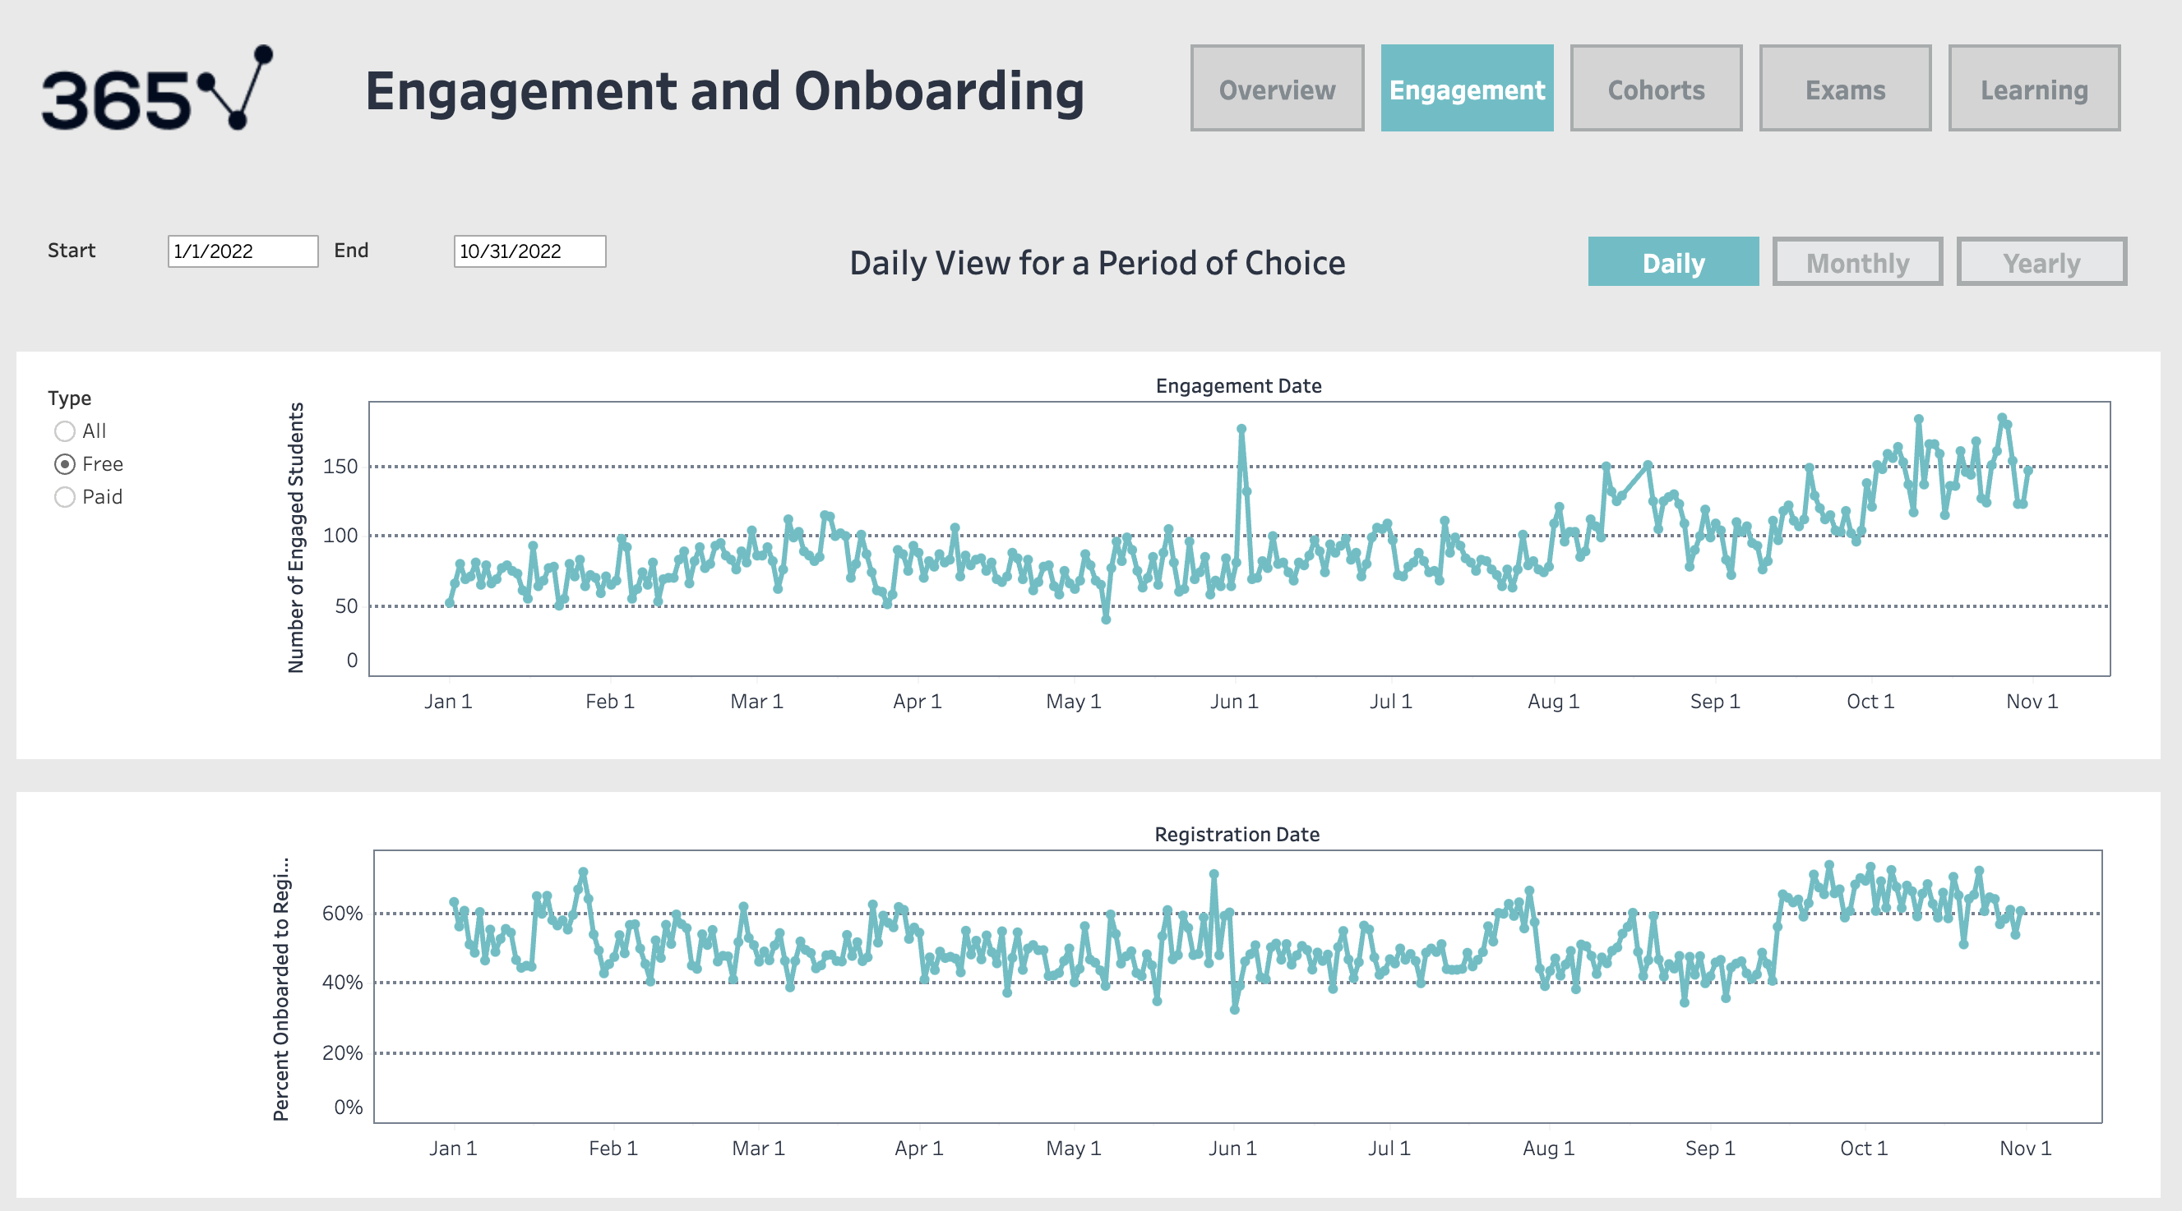

Slide 9
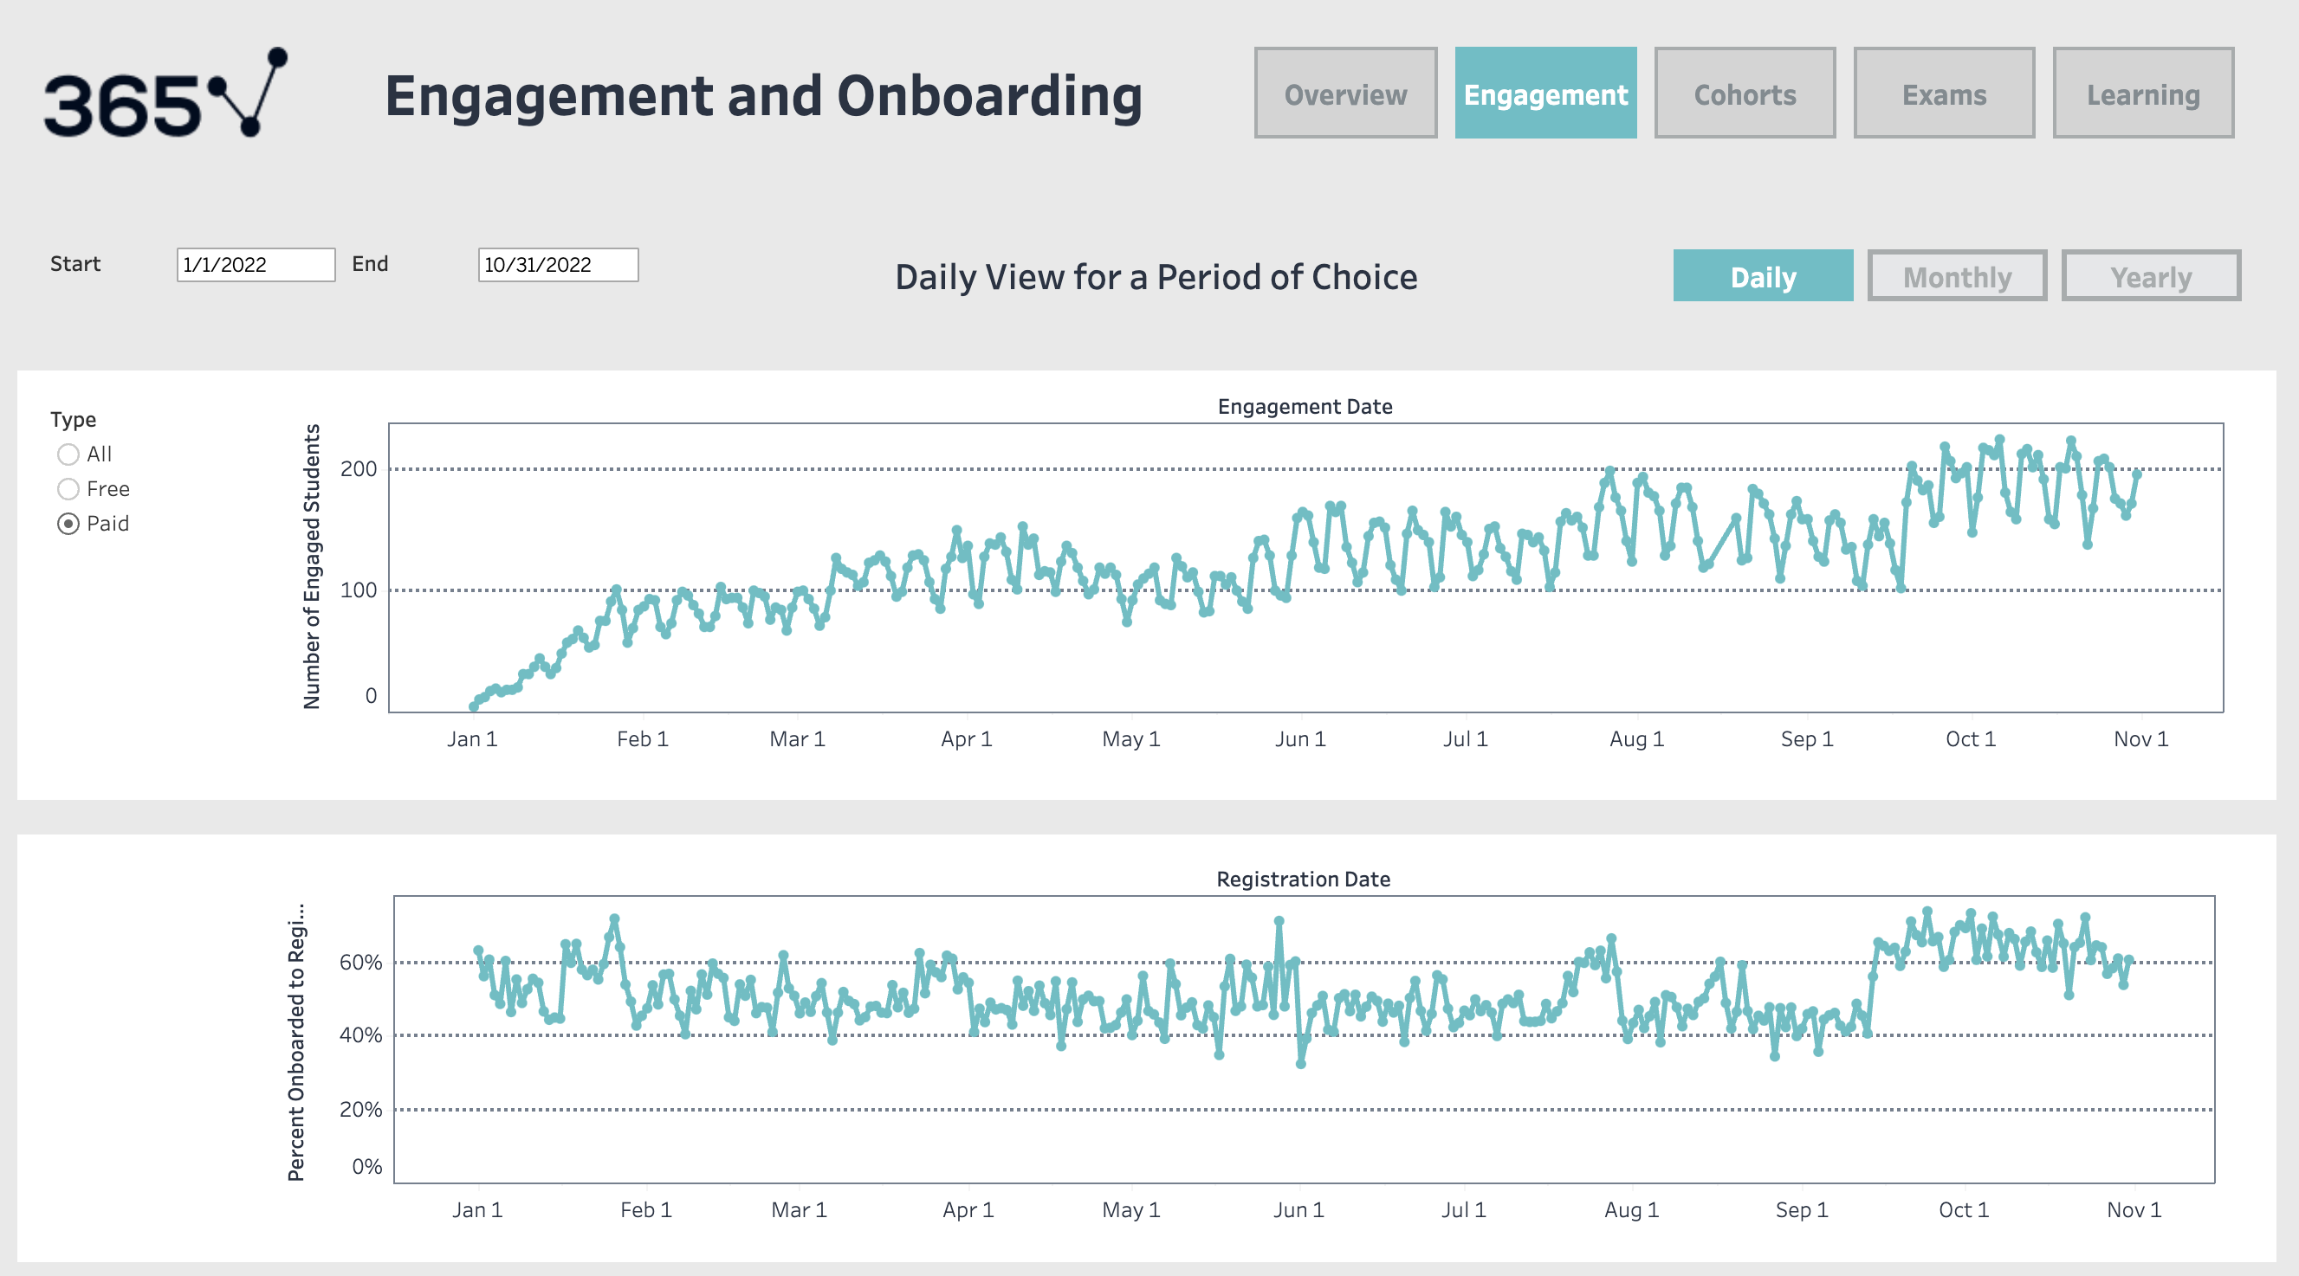

Slide 11
Key Questions
How engaged are the students inside the platform, and how can this metric be improved?
How long do students stay engaged on the platform, and how can this period be extended?
What’s the difference in behavior between free and paid students?
Which are the most popular courses on the platform?
How many students sit for an exam?

Slide 12
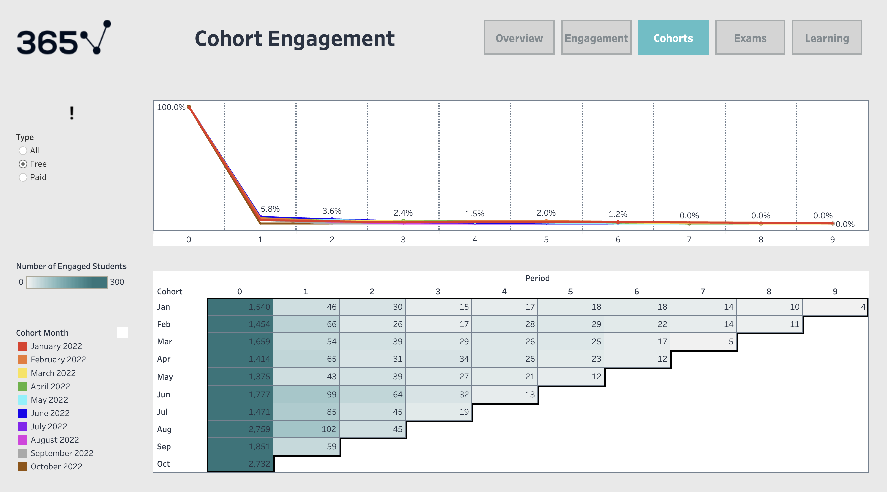

Slide 13
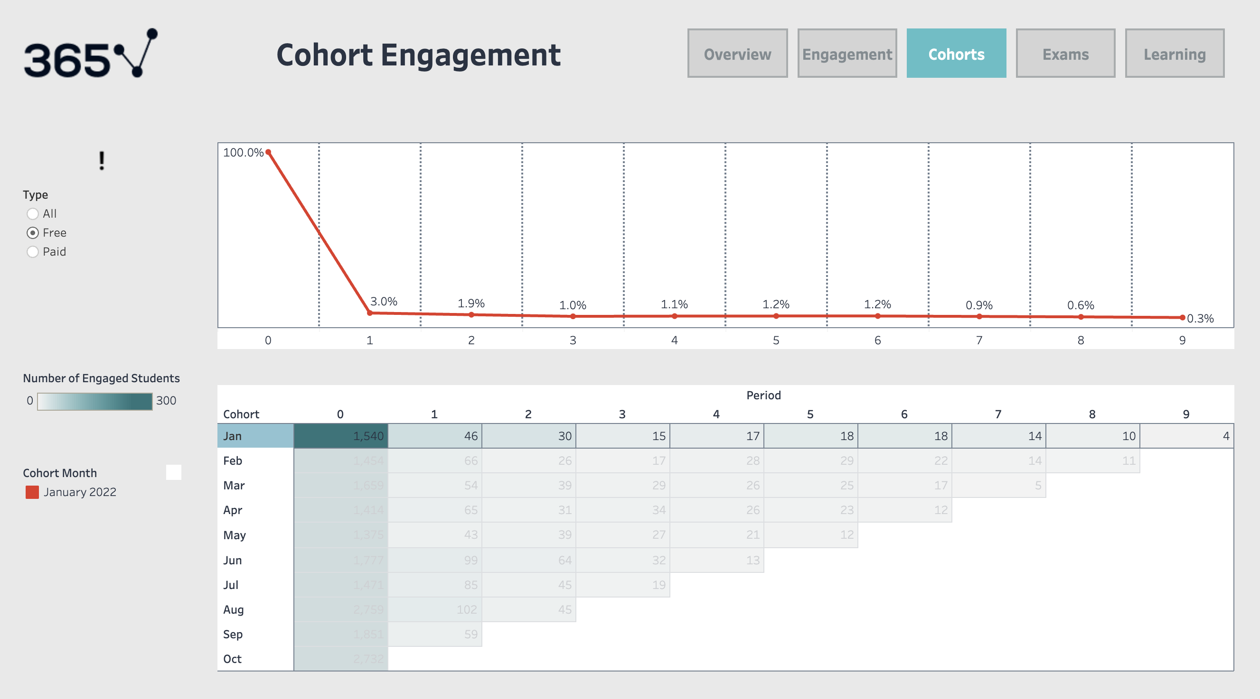

Slide 14
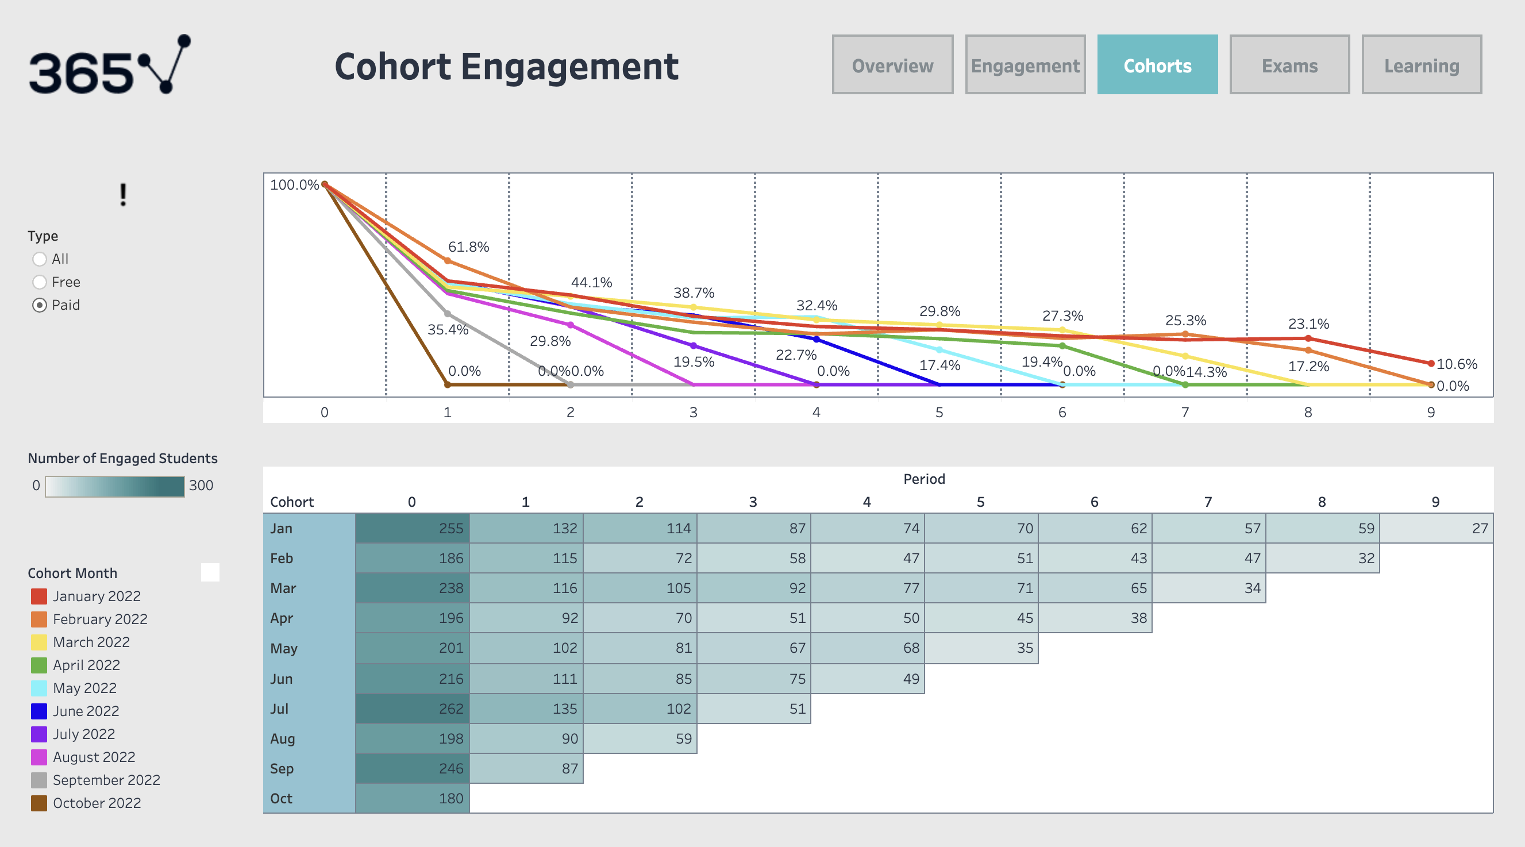

Slide 15
Key Questions
How engaged are the students inside the platform, and how can this metric be improved?
How long do students stay engaged on the platform, and how can this period be extended?
What’s the difference in behavior between free and paid students?
Which are the most popular courses on the platform?
How many students sit for an exam?

Slide 18
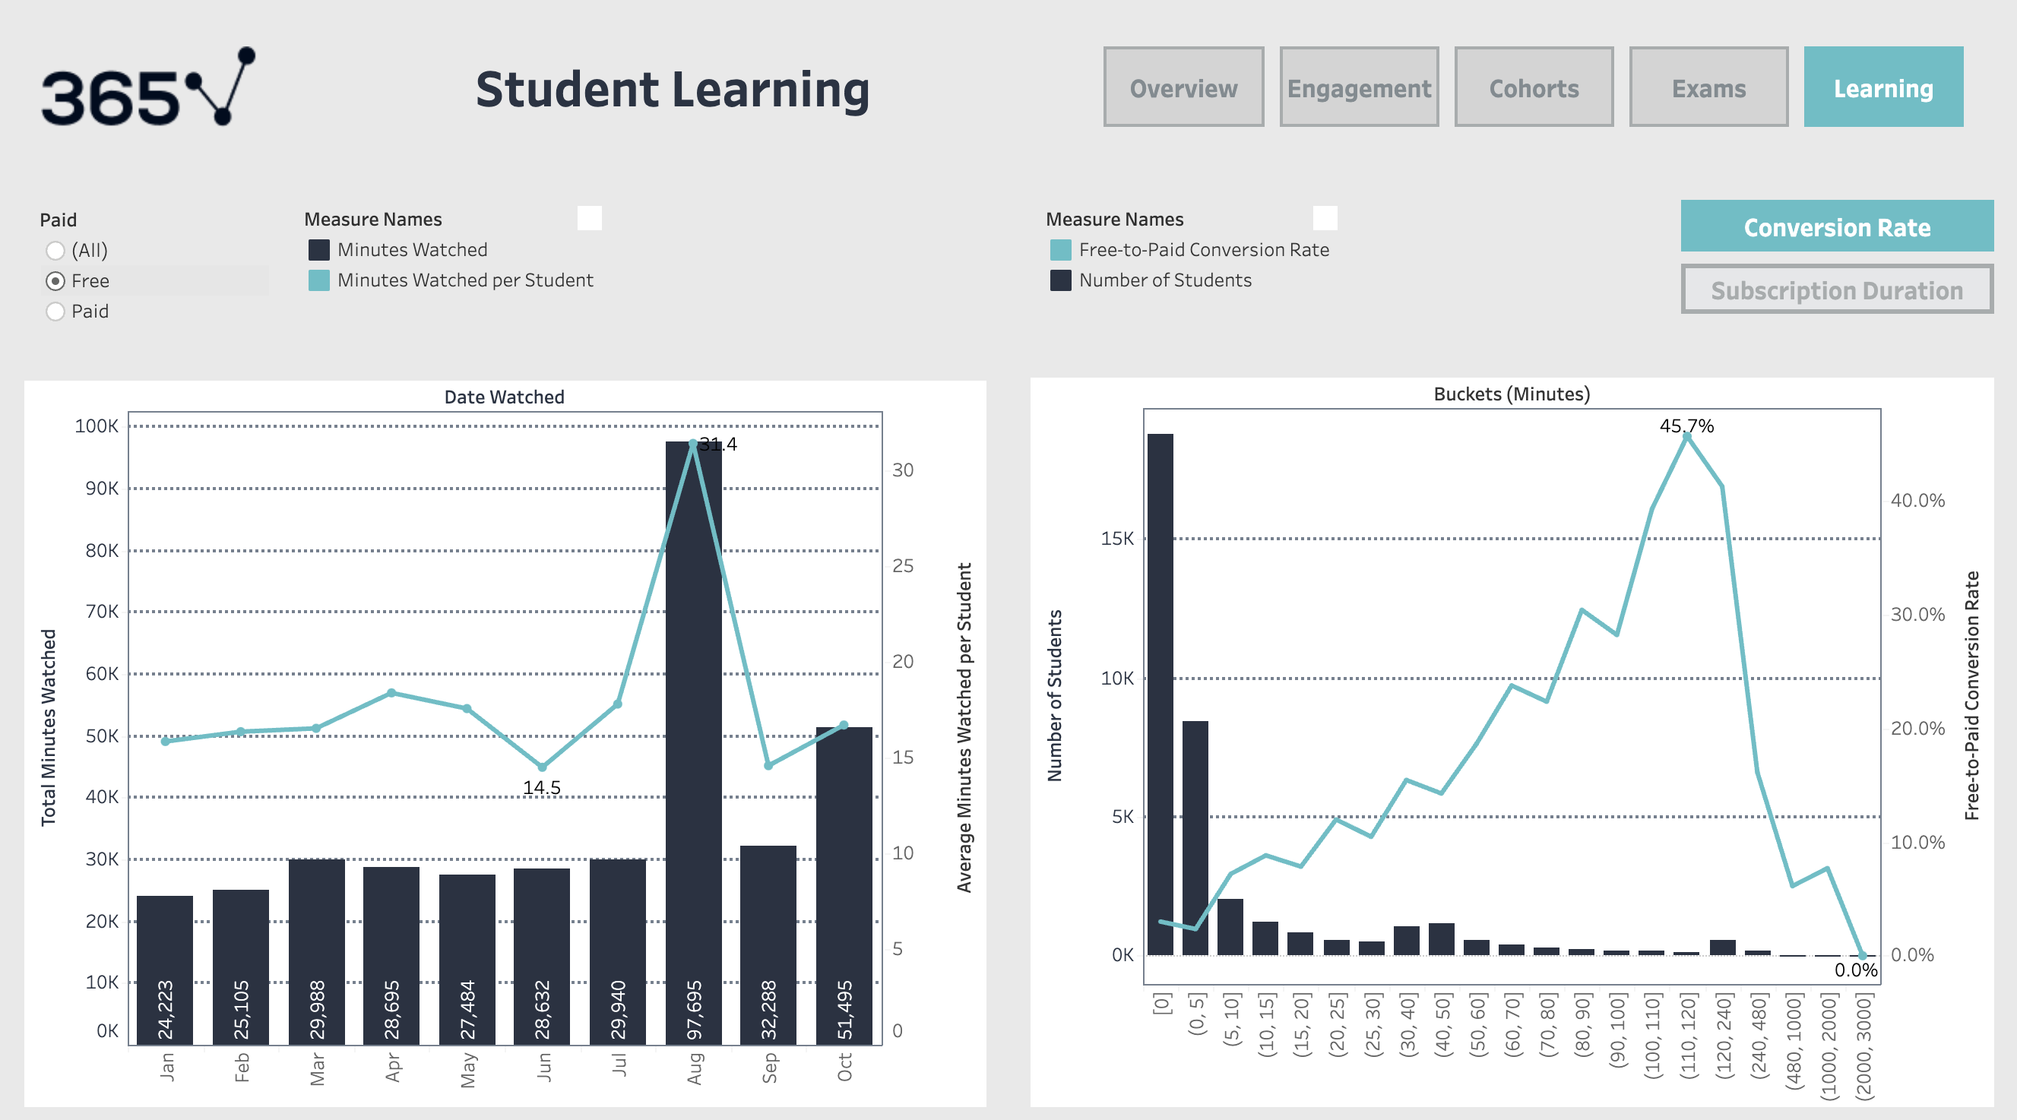

Slide 19
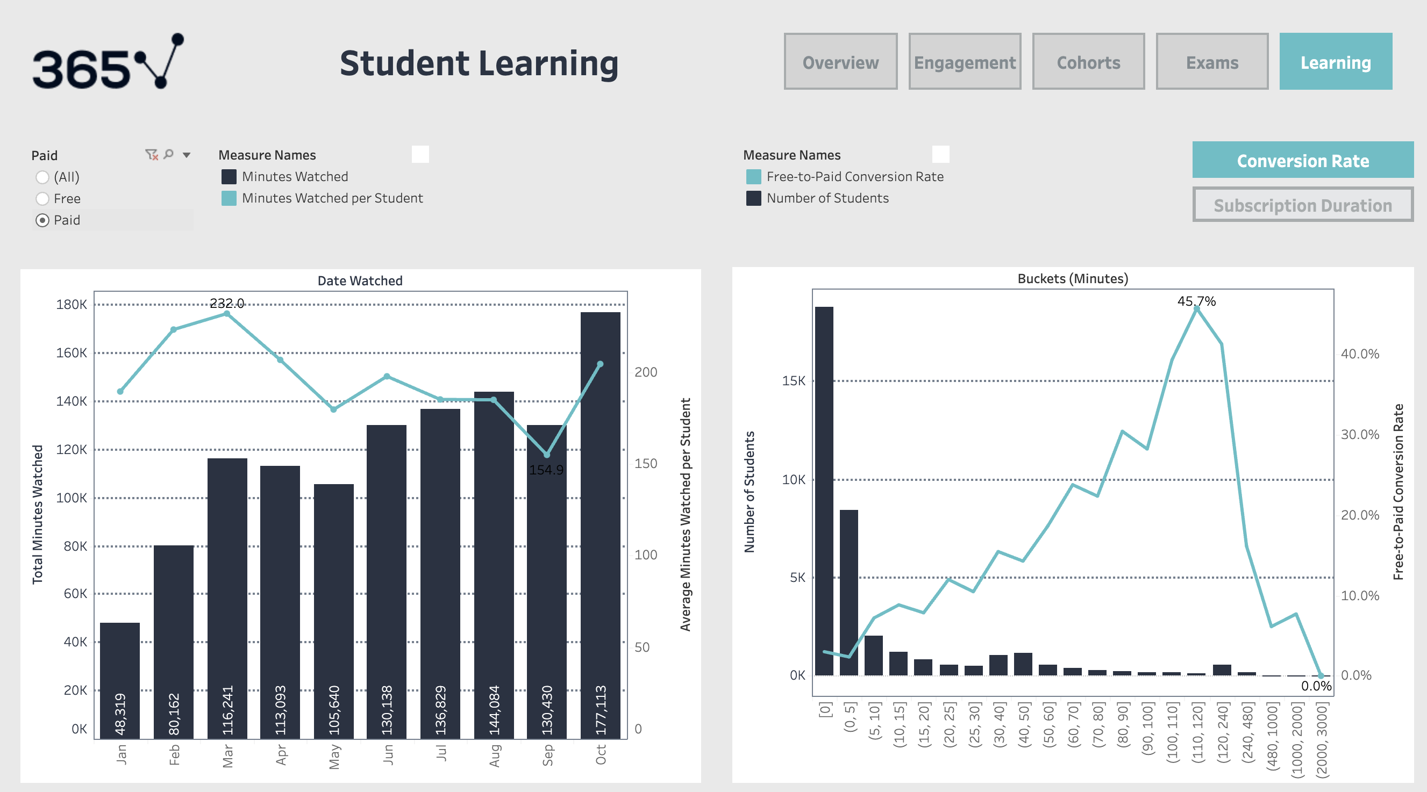

Slide 21
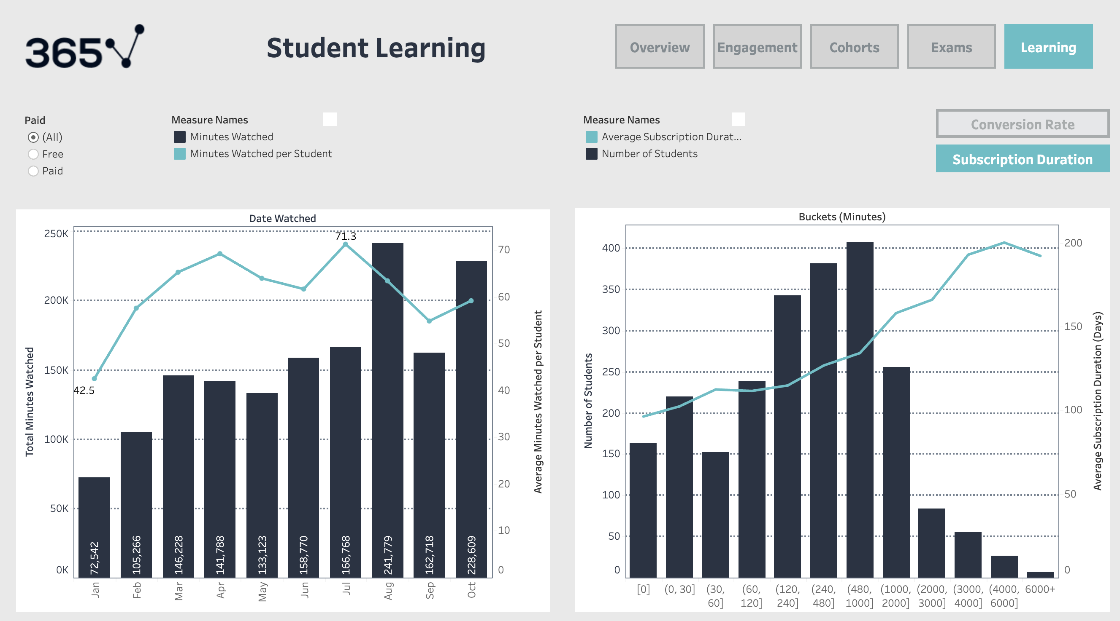

Slide 22
Key Questions
How engaged are the students inside the platform, and how can this metric be improved?
How long do students stay engaged on the platform, and how can this period be extended?
What’s the difference in behavior between free and paid students?
Which are the most popular courses on the platform?
How many students sit for an exam?

Slide 24
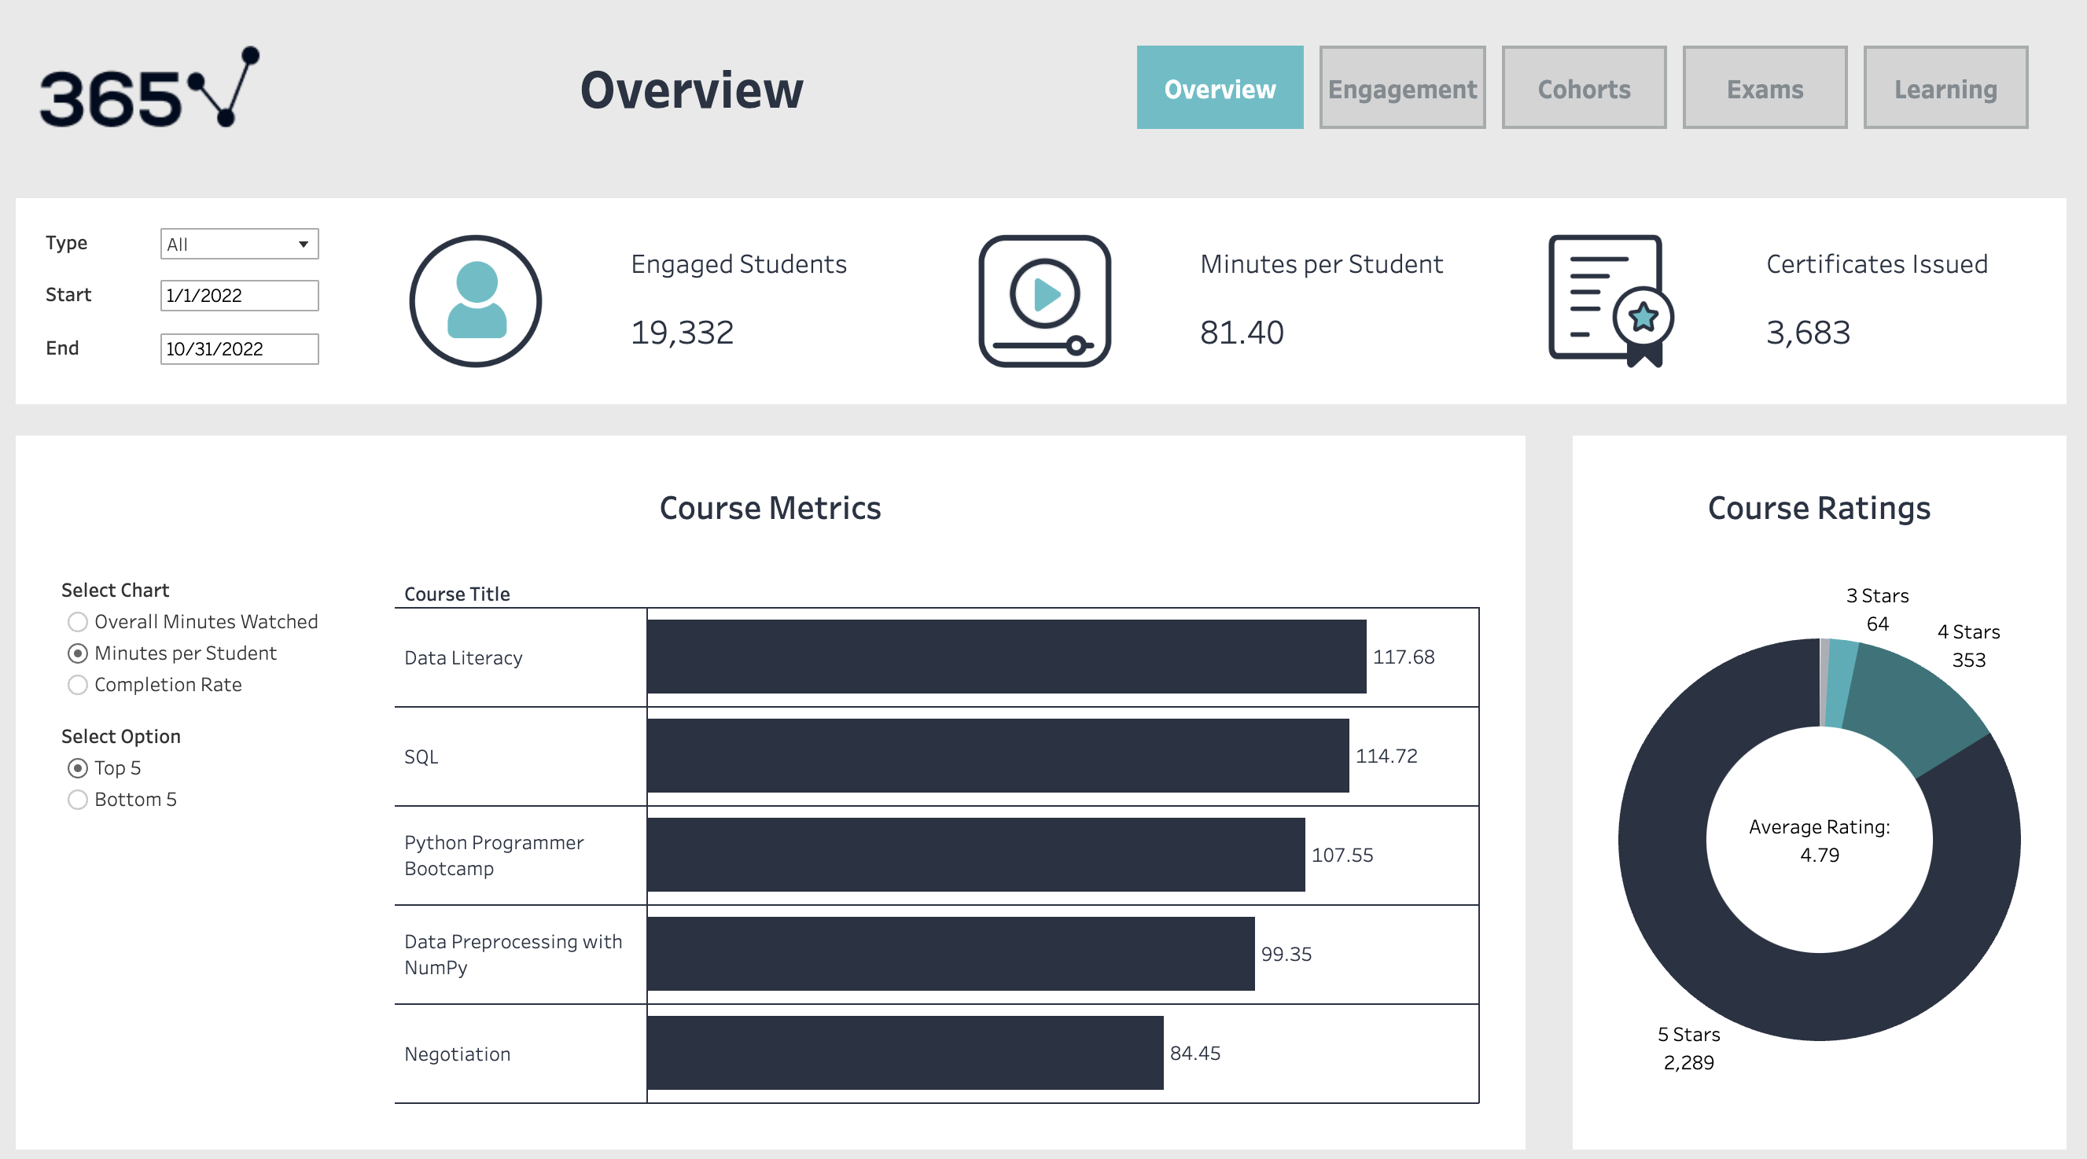

Slide 25
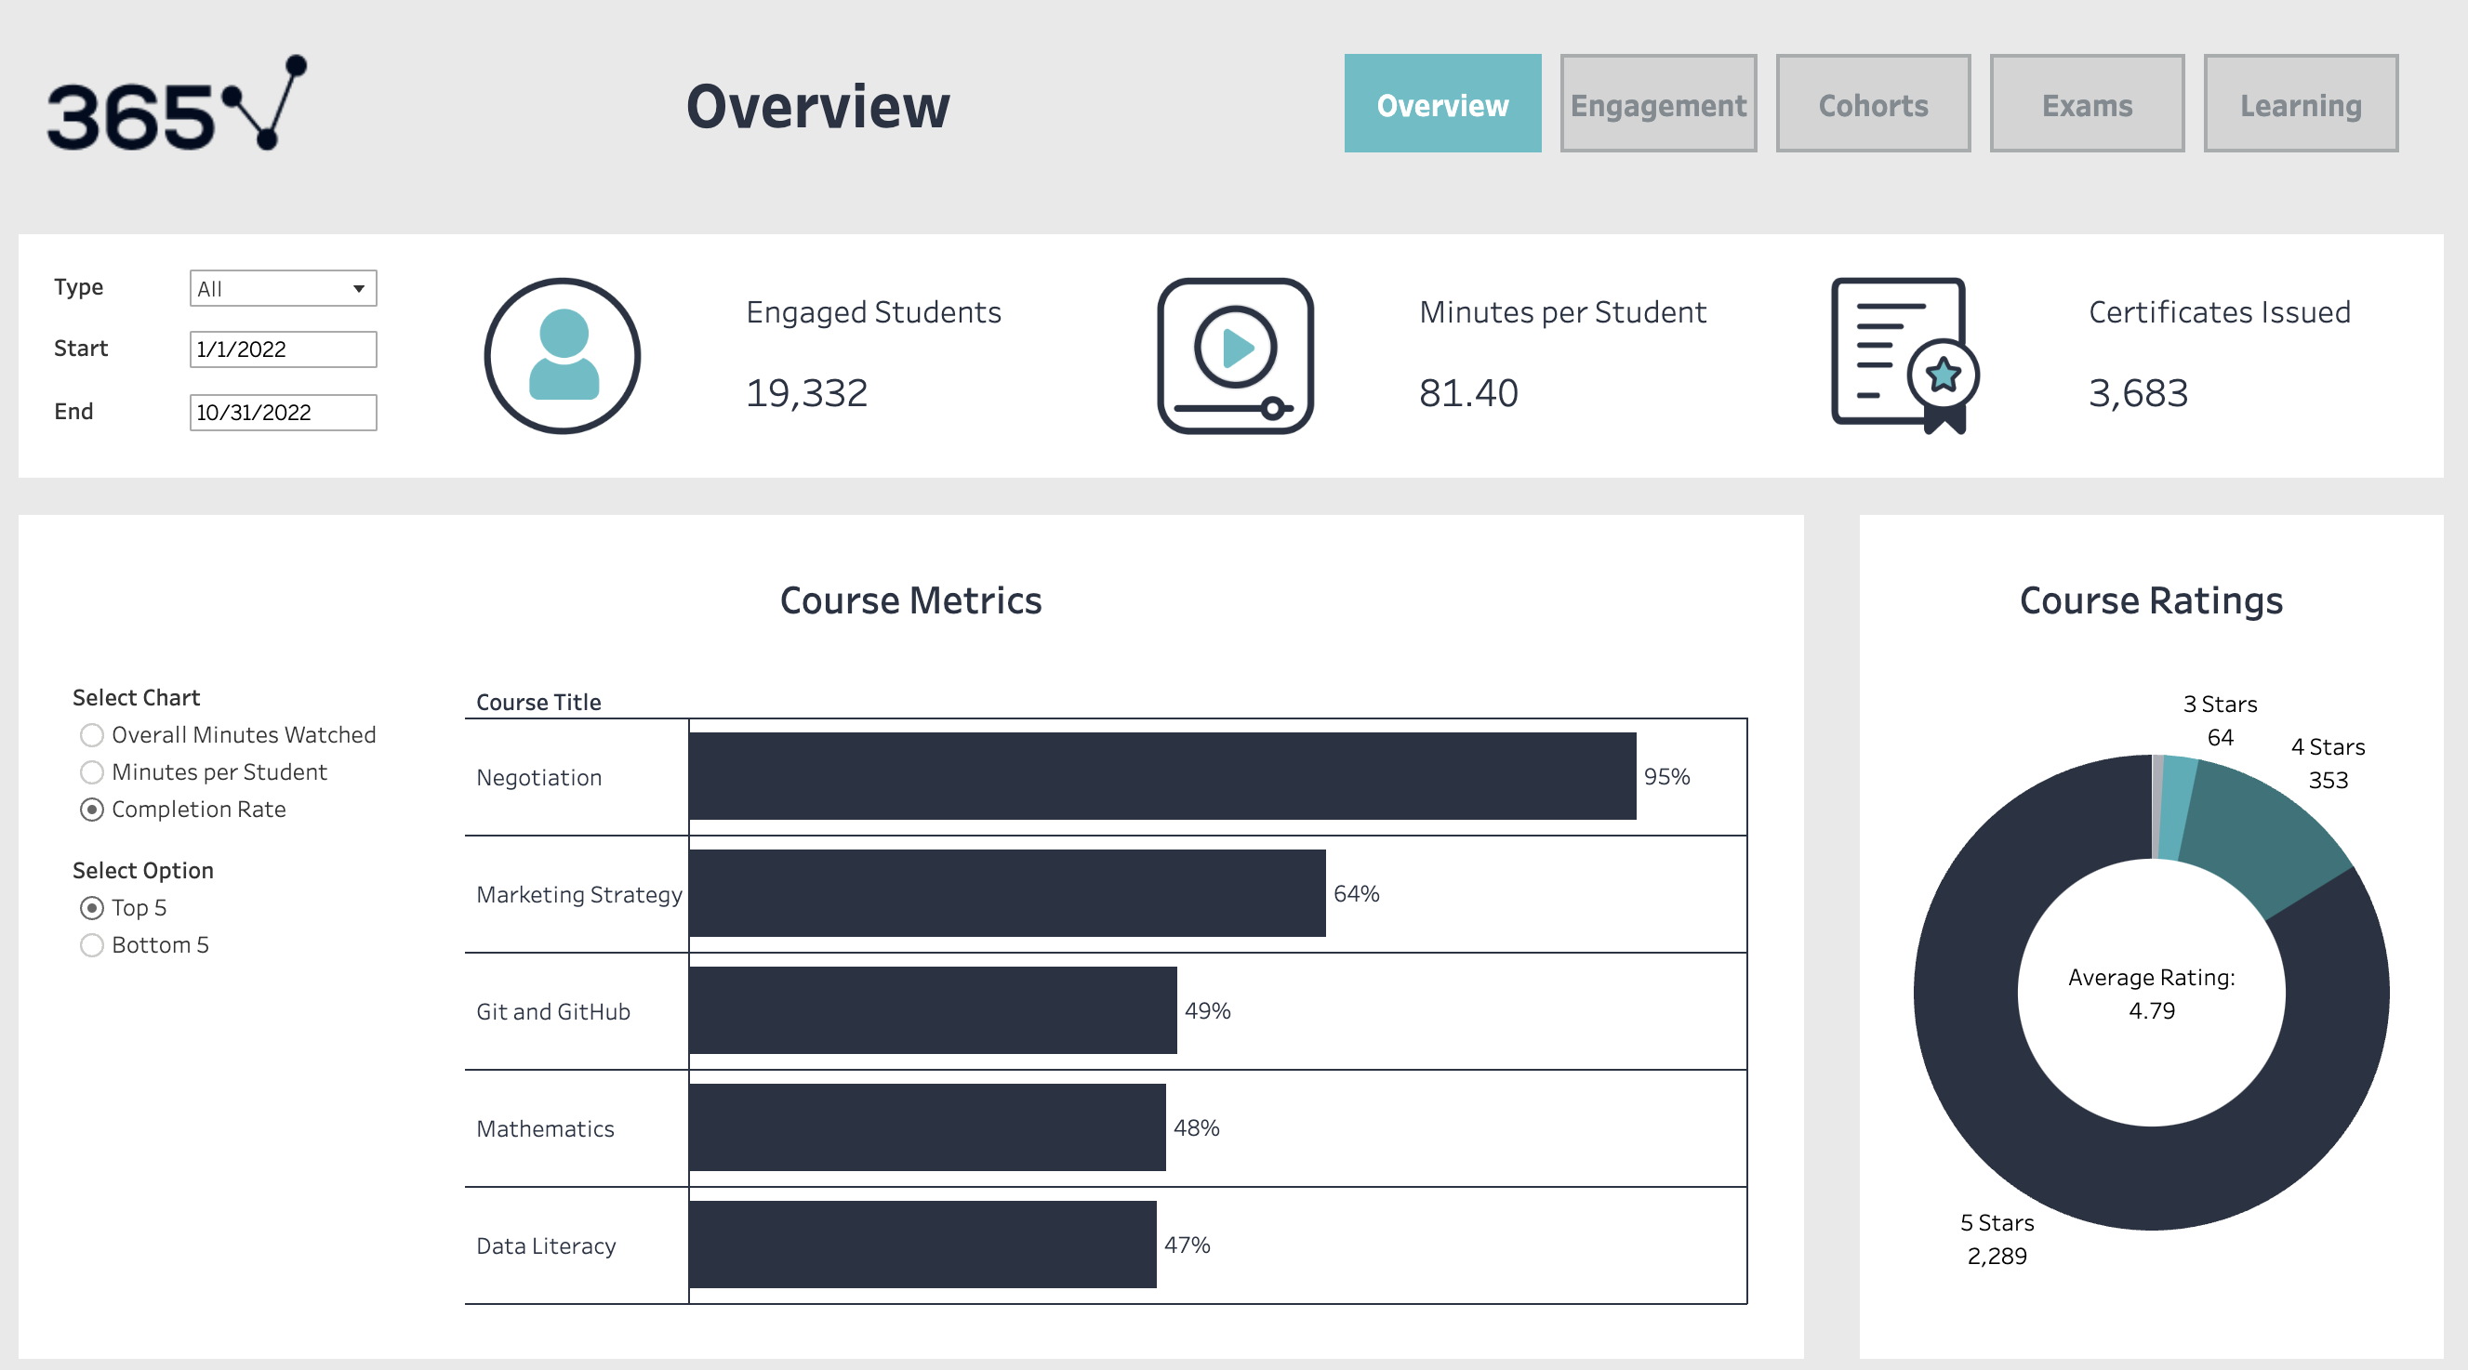

Slide 26
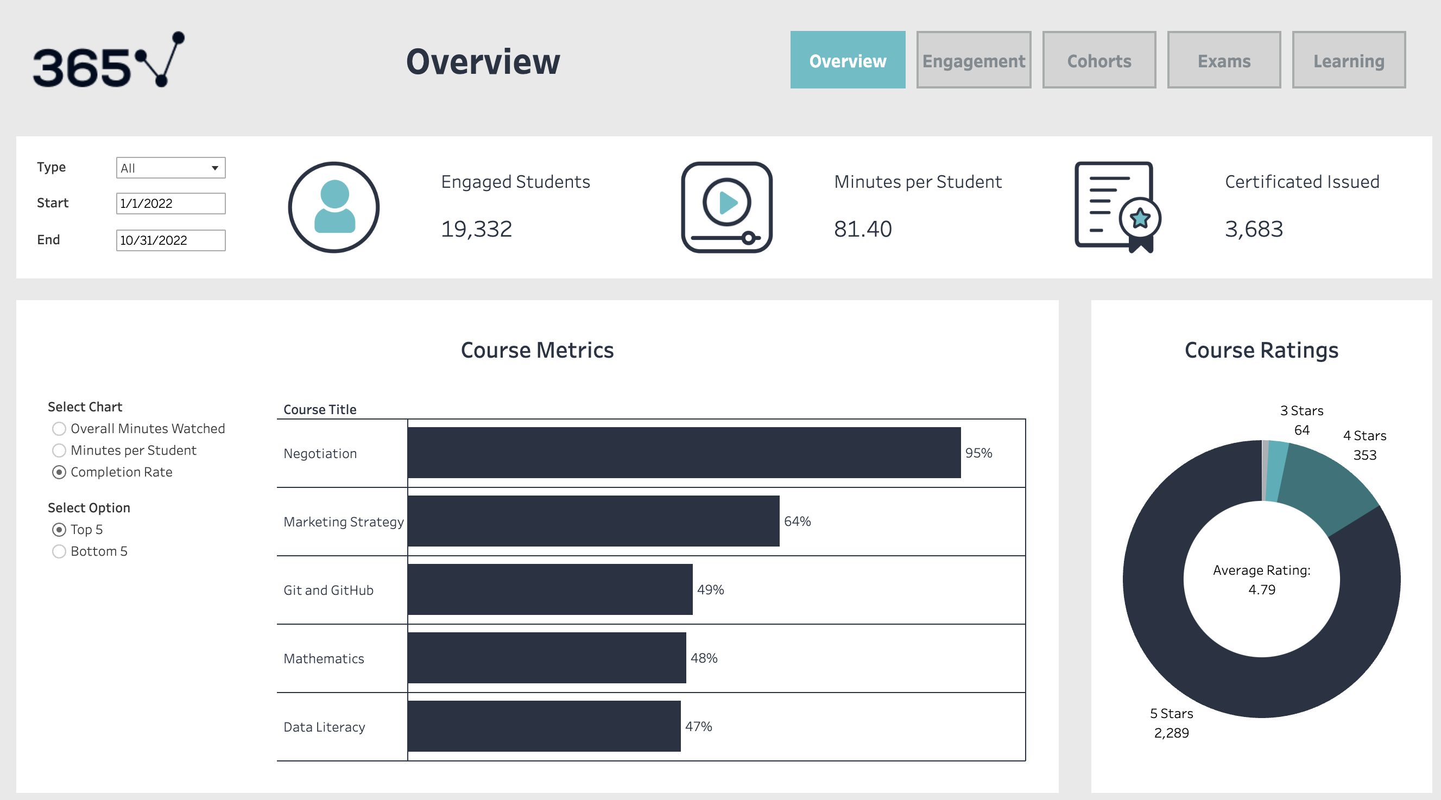

Slide 27
Key Questions
How engaged are the students inside the platform, and how can this metric be improved?
How long do students stay engaged on the platform, and how can this period be extended?
What’s the difference in behavior between free and paid students?
Which are the most popular courses on the platform?
How many students sit for an exam?

Slide 28
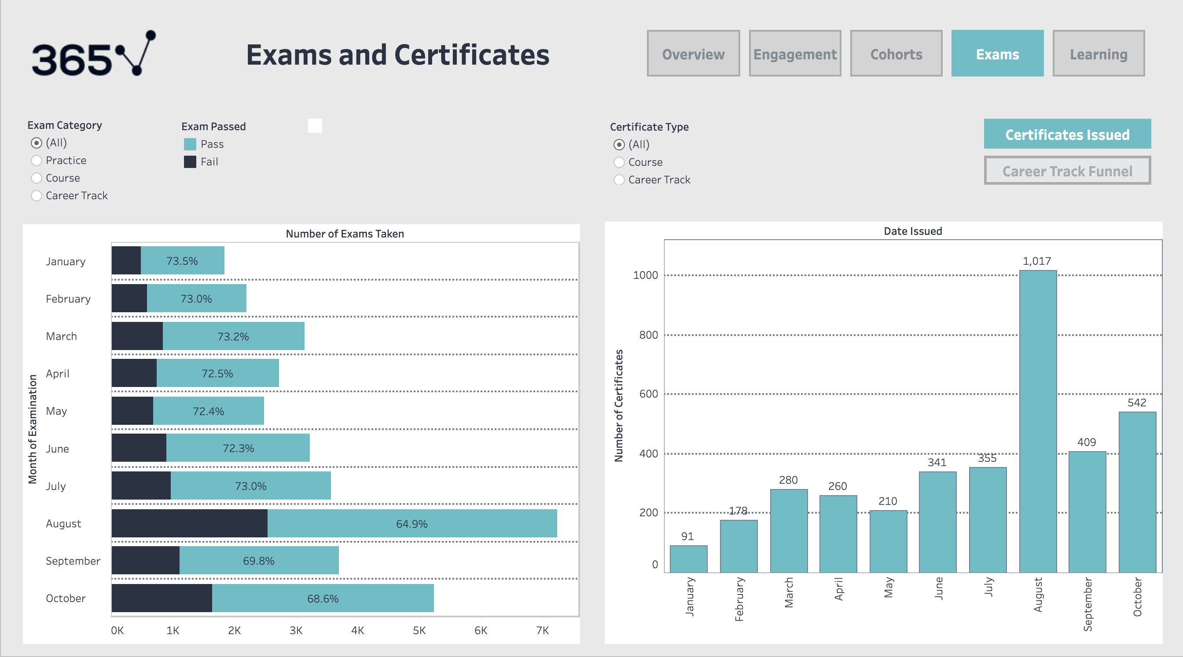

Slide 29
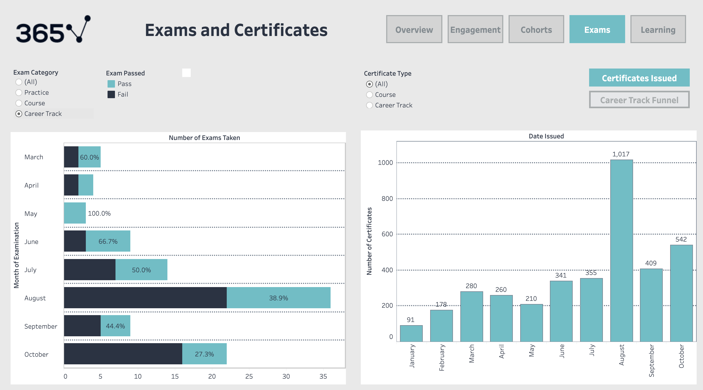

Slide 33
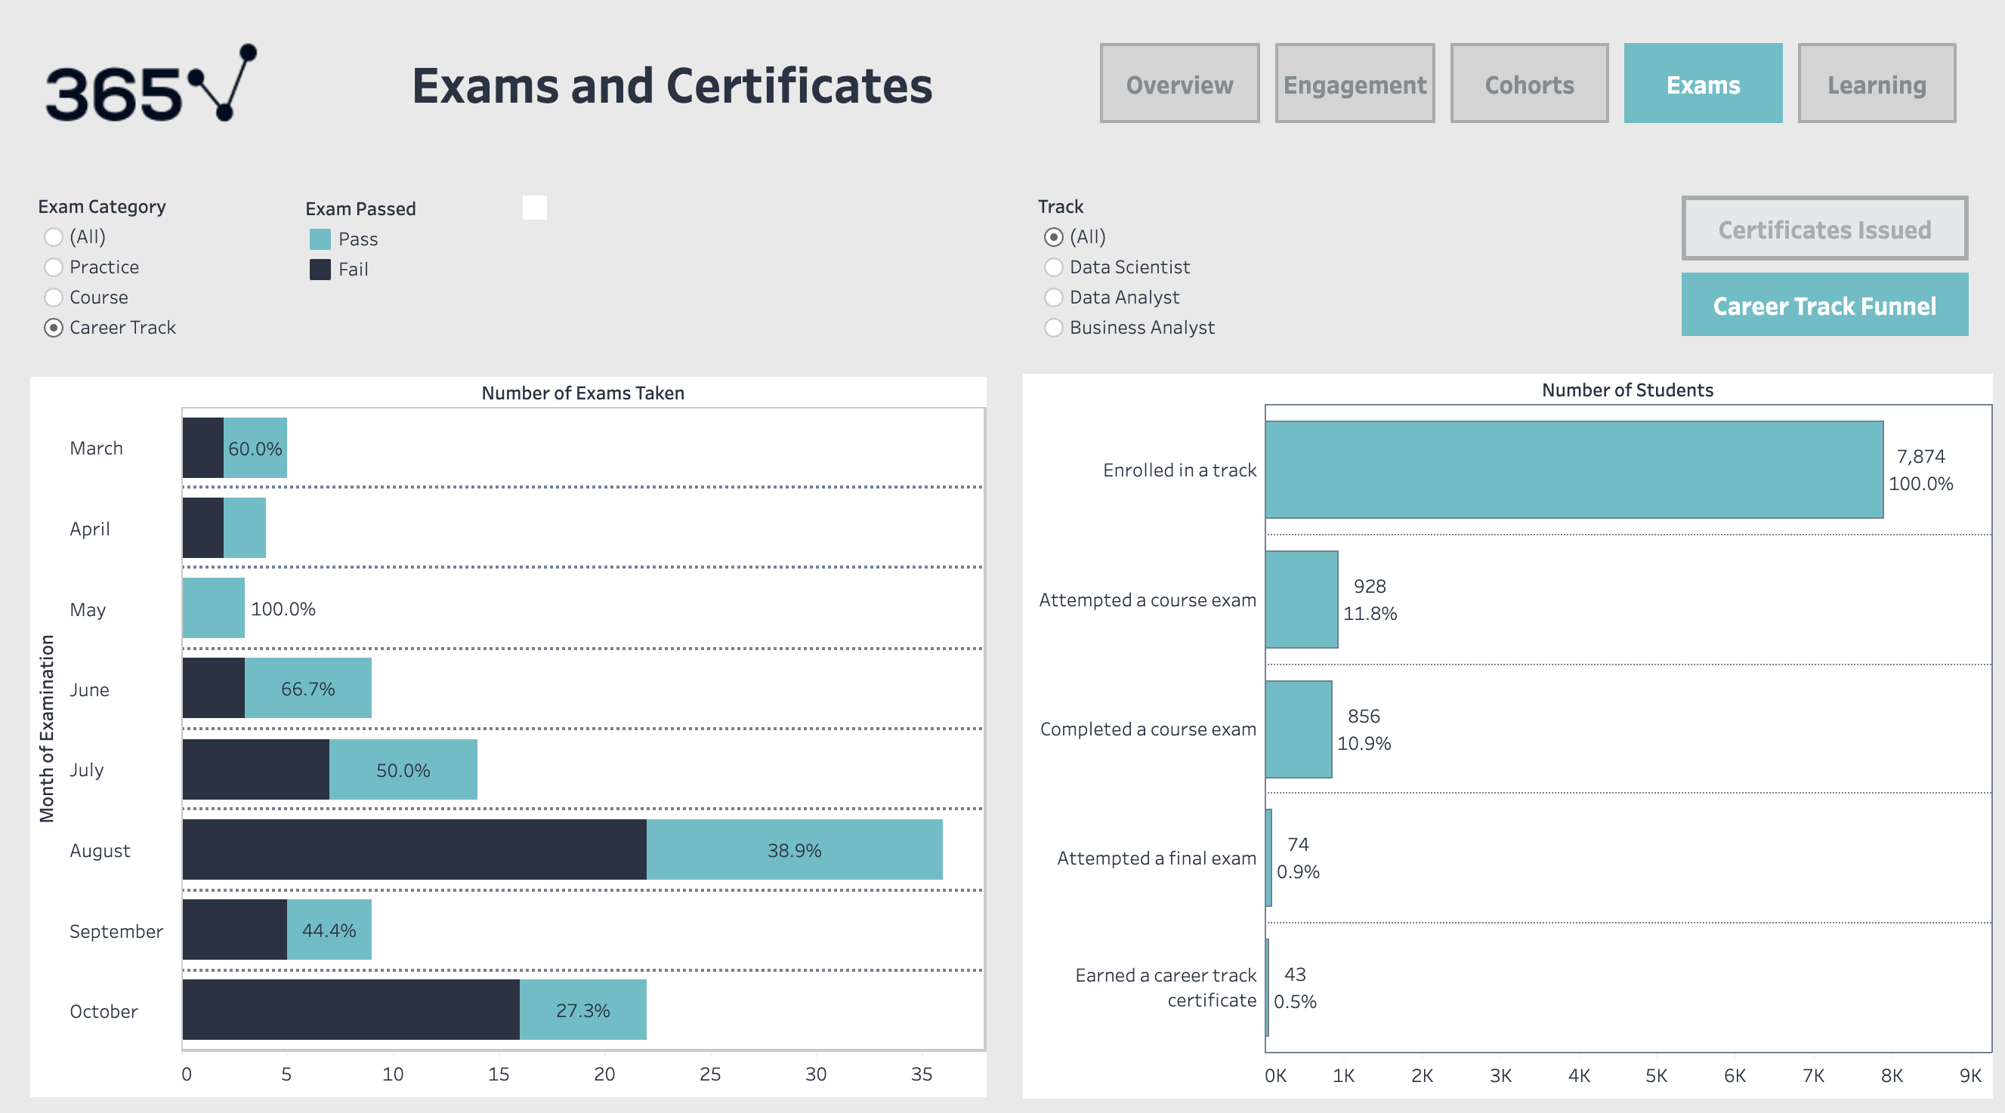

Slide 35
Recommendations
Increase marketing campaigns during low engagement periods.
Advertise gamification features to boost free-to-paid conversion rate.
Monitor the impact of gamification on engagement to avoid novelty effects.
Investigate and improve the career track exam process to increase pass rates and engagement.
Maintain high course quality while addressing any identified issues from low ratings.

Slide 36
Registered-to-Onboarding Rate: 40-60%
Industry Benchmark: 30-50%
Recommendations:
Increase marketing campaigns during low engagement periods.
Advertise gamification features to boost free-to-paid conversion rate.
Monitor the impact of gamification on engagement to avoid novelty effects.
Investigate and improve the career track exam process to increase pass rates and engagement.
Maintain high course quality while addressing any identified issues from low ratings.

Slide 37
Recommendations:
Increase marketing campaigns during low engagement periods.
40% increase in engaged students in the last three months compared to the beginning months
33% increase in engaged students following the August promotion
Advertise gamification features to boost free-to-paid conversion rate.
Onboarding rate increased to about 70% following September 16th
17% of students who watched 30-60 minutes of content converted to paying students
42% who watched 2 hours converted

Slide 38
Recommendations:
Monitor the impact of gamification on engagement to avoid novelty effects.
37% increase in the average number of paying students following September 16th

Slide 39
Recommendations:
Investigate and improve the career track exam process to increase pass rates and engagement.
Career track exams have the lowest attempt and pass rates
Suggestion: investigate potential drawbacks
exam difficulty or time constraints
A/B tests to identify areas of improvements
Maintain high course quality while addressing any identified issues from low ratings.
Average Course Rating: 4.79 stars

Slide 40
Recommendations
Increase marketing campaigns during low engagement periods.
Advertise gamification features to boost free-to-paid conversion rate.
Monitor the impact of gamification on engagement to avoid novelty effects.
Investigate and improve the career track exam process to increase pass rates and engagement.
Maintain high course quality while addressing any identified issues from low ratings.

Slide 41
Thank You
Contact Info:
Email: miguel.pricila98@gmail.com
LinkedIn: linkedin.com/pricila-miguel
GitHub: github.com/pricilamiguel
Tableau: public.tableau.com/pricila.miguel

